Slide 1
Easy-Seed-Saver: Why?
It is advisable not to digitally create and save the seed
The seed is the be-all and end-all in dealing with your IOTA
Every type of digital storage is vulnerable and traceable
Whoever has the seed has access to your credit. Without the seed, your credit is in danger and possibly lost

Slide 2
Easy-Seed-Saver: That’s why!
All electronic storage media are destroyed in a fire and can otherwise be damaged. Your cloud can be hacked and, as a central system, it is also not secure. Your paper wallet is not fire and waterproof.
The Easy Seed Saver is fire and water resistant. It is not managed centrally like a cloud. Since the Easy Seed Saver is analog, it cannot be attacked electronically.

Slide 3
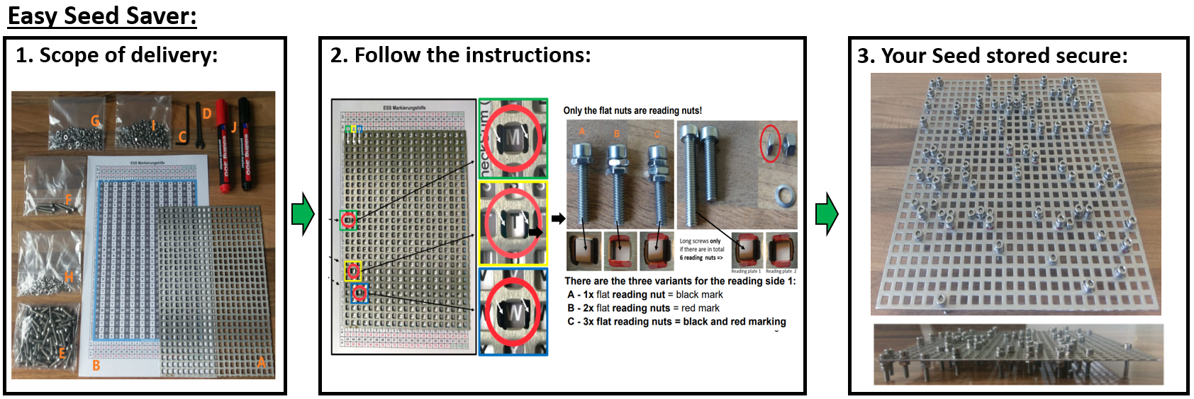
Easy-Seed-Saver: That’s why!

Slide 4

Easy-Seed-Saver: Where?
You can find the Easy Seed Saver and other analog storage media for crypto passwords and general passwords at:
www.easy-passphrase-saver.de

